Slide 1
Benha University
Faculty of Science
Department of Zoology
METAZOA
إعداد : د. دعاء صبرى إبراهيم
مدرس بقسم علم الحيوان

Slide 2
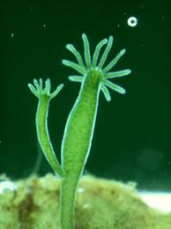
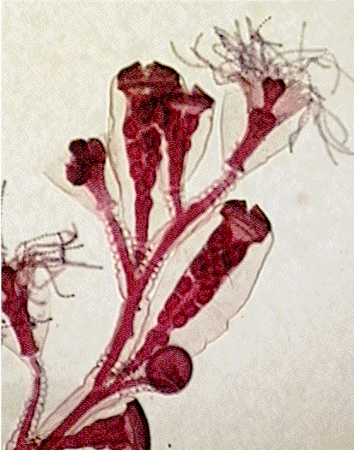
Subkingdom: Metazoa Phylum: Coelenterata

Slide 3
General Characters of Coelenterata
All are aquatic, mostly marine but a few freshwater including the well-known hydras.
Individuals may be either solitary or colonial, and sedentary or free-swimming.
Body is almost radically symmetrical.

Slide 4
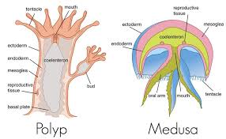
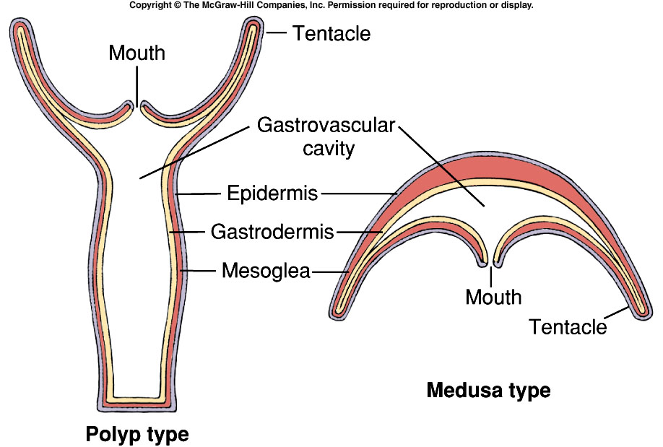
Two types of body structures are characteristic, a sessile Hydra-like “polyp or hydroid form” and a free swimming jellyfish-like “medusa or medusoid form”. The Life-history commonly illustrates the phenomenon of alternation of generation, in which a sexual free swimming medusoid generation alternates with an asexual, sessile, usually colonial, polypoid generation.
.

Slide 5
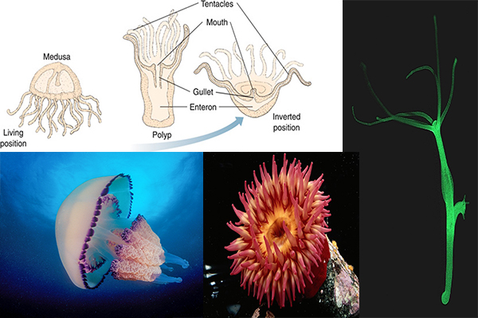
Short and slender, extensile projections, called tentacles, encircle the mouth and used for food capture, intake and defense.

Slide 6
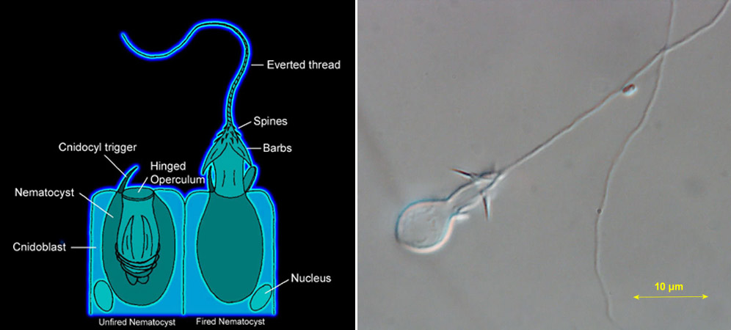
They possess characteristic stinging cysts, known as the nematocysts or cindoblasts, which are not found in any other phylum.

Slide 7
The body wall is solid and diploblastic, that is composed of two definite cellular layers epidermis or ectoderm and gastrodermis or endoderm between these two layers is gelatinous non-cellular, intermediate supporting layer, the mesoglea.

Slide 8
The body wall encloses a single internal cavity called enteron or gastrovascular cavity.
Digestion is partly extracellular occurring in the gastrovascular cavity, and partly intracellular taking place within food vacuoles inside the endodermal cells.
Respiration and excretion take place by simple diffusion through the surface of the ectoderme and endoderm.
Nervous system is primitive consisting of a diffuse network of unpolarized nerve cells in the body wall.
Sensory organs may be simple or complicated, some with eyespots or statocysts.

Slide 9
Reproduction is both asexual by budding and regeneration, or sexual by ova and sperms. Some species may be hermaphroditic. But sexes are usually separate. The larva is ciliated and called planula.
Coelenterata are classified into three classes: Hydrozoa, Scyphozoa and Actinozoa.

Slide 10
Class: Hydrozoa
1- Mostly marine and colonial. They have polyp and medusa stages in their life cycle, one of these stages may be absent.
2- The hydrozoan polyp is characterised by having an oral cone, solid tentacles and simple sac-like gastrovascular cavity not divided by internal partitions or mesenteries.
3- The mesoglea in the Hydrozoa is never cellular, and the gastrodermis lacks nematocytes.

Slide 11
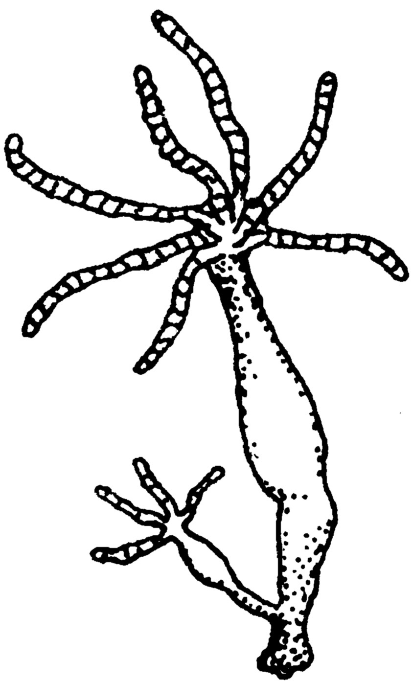
Subkingdom: Metazoa Phylum: Coelenterata Class: Hydrozoa e.g.: Hydra

Slide 12
Cellular structure

Slide 13
Nematocytes

Slide 14
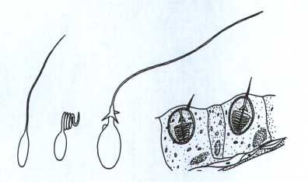
Types of nematocystes
Penetrant
Volvent
Glutinant

Slide 15
Locomotion
Gliding
Walking
Somersaulting
Floating

Slide 16
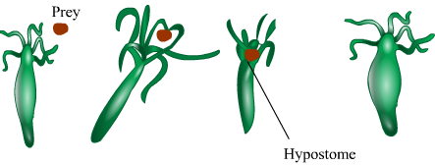
Nutrition
Extracellular digestion takes place, the gland cells secrete all enzymes that act on the proteins. The food is taken by the pseudopodia of the musculo-nutritive cells, where intracellular digestion begins in the food vacuoles of these cells and the digestion of proteins and fats is completed

Slide 17
Respiration and Excretion
By simple diffusion

Slide 18
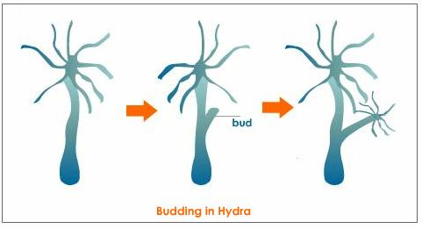
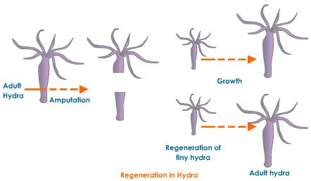
Asexual reproduction
_ Budding
_ Regeneration

Slide 19
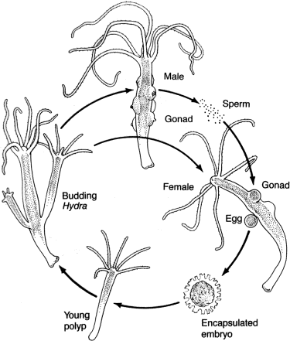
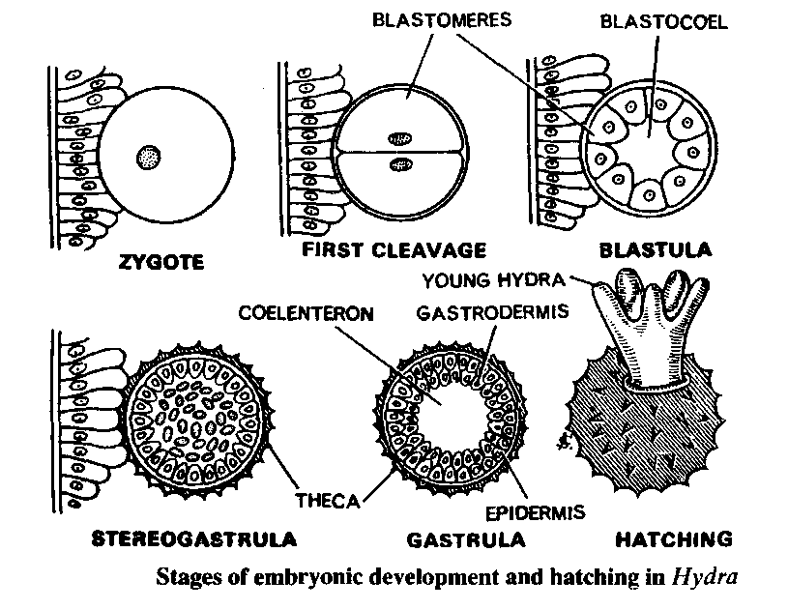
Sexual reproduction

Slide 20
مع تمنياتى لكم بالنجاح والتوفيق
لمزيد من المعلومات
http://www.bu.edu.eg/staff/doaamohamed7-courses

